Slide 1
UNIT 3-Auto Associative memory and Hetero Associative memory
Prof. Shilpa Gaikwad
TE AIDS

Slide 2
Associative Memory Networks
An associative memory network can store a set of patterns as memories.
When the associative memory is being presented with a key pattern, it responds by producing one of the stored patterns, which closely resembles or relates to the key pattern.
Thus, the recall is through association of the key pattern, with the help of information memorized.
These types of memories are also called as content-addressable memories (CAM).
The CAM can also be viewed as associating data to address, i.e.; for every data in the memory there is a corresponding unique address.
Also, it can be viewed as data correlator. Here input data is correlated with that of the stored data in the CAM.
It should be noted that the stored patterns must be unique, i.e., different patterns in each location.
If the same pattern exists in more than one location in the CAM, then, even though the correlation is correct, the address is noted to be ambiguous.
Associative memory makes a parallel search within a stored data file.
The concept behind this search is to Output any one or all stored items which match the given search argument.

Slide 3
Associative Memory Networks
An associate memory network refers to a content addressable memory structure that associates a relationship between the set of input patterns and output patterns.
A content addressable memory structure is a kind of memory structure that enables the recollection of data based on the intensity of similarity between the input pattern and the patterns stored in the memory.

Slide 4
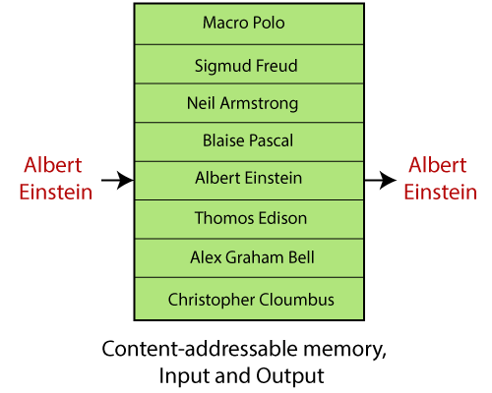
Let's understand this concept with an example

Slide 5
Let's understand this concept with an example
The figure given below illustrates a memory containing the names of various people.
If the given memory is content addressable, the incorrect string "Albert Einstein" as a key is sufficient to recover the correct name "Albert Einstein."
In this condition, this type of memory is robust and fault-tolerant because of this type of memory model, and some form of error-correction capability.

Slide 6
Types of associate memory
There are two types of associate memory-
Auto-associative memory
Hetero associative memory
Auto-associative memory:
An auto-associative memory recovers a previously stored pattern that most closely relates to the current pattern. It is also known as an auto-associative correlator.

Slide 7
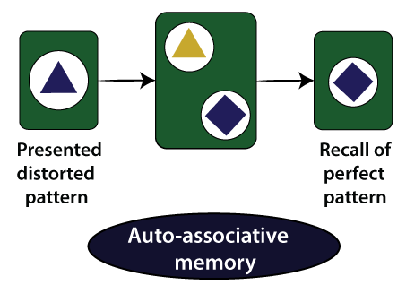
Auto-associative memory:

Slide 8
Auto-associative memory
Consider x[1], x[2], x[3],….. x[M], be the number of stored pattern vectors, and let x[m] be the element of these vectors, showing characteristics obtained from the patterns.
The auto-associative memory will result in a pattern vector x[m] when putting a noisy or incomplete version of x[m].

Slide 9
Hetero-associative Memory
In a hetero-associate memory, the recovered pattern is generally different from the input pattern not only in type and format but also in content. It is also known as a hetero-associative correlator.
Consider we have a number of key response pairs {a(1), x(1)}, {a(2),x(2)},…..,{a(M), x(M)}. The hetero-associative memory will give a pattern vector x(m) when a noisy or incomplete version of the a(m) is given.
Neural networks are usually used to implement these associative memory models called neural associative memory (NAM). The linear associate is the easiest artificial neural associative memory.
These models follow distinct neural network architecture to memorize data.

Slide 10
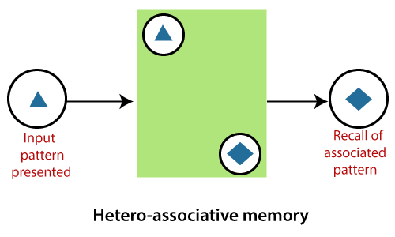
Hetero-associative Memory

Slide 11
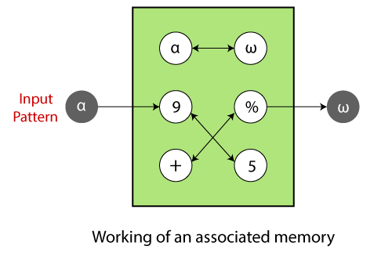
Working of Associative Memory
Associative memory is a depository of associated pattern which in some form. If the depository is triggered with a pattern, the associated pattern pair appear at the output.
The input could be an exact or partial representation of a stored pattern.

Slide 12
Working of Associative Memory
If the memory is produced with an input pattern, may say α, the associated pattern ω is recovered automatically.
These are the terms which are related to the Associative memory network:
Encoding or memorization:
Encoding or memorization refers to building an associative memory.
It implies constructing an association weight matrix w such that when an input pattern is given, the stored pattern connected with the input pattern is recovered.
(Wij)k = (pi)k (qj)k
Where,
(pi)k represents the ith component of pattern pk, and
(qj)k represents the jth component of pattern qk
Where, i = 1,2, …,m and j = 1,2,…,n.

Slide 13

Working of Associative Memory
Constructing the association weight matrix w is accomplished by adding the individual correlation matrices wk , i.e.,
Where α = Constructing constant.

Slide 14
Performance Measures
The measures taken for the associative memory performance to correct recovery are memory capacity and content addressability.
Memory capacity can be defined as the maximum number of associated pattern pairs that can be stored and correctly recovered.
Content- addressability refers to the ability of the network to recover the correct stored pattern.
If input patterns are mutually orthogonal, perfect recovery is possible.
If stored input patterns are not mutually orthogonal, non-perfect recovery can happen due to intersection among the patterns.

Slide 15
Associative memory models
Linear associator is the simplest and most widely used associative memory models.
It is a collection of simple processing units which have a quite complex collective computational capability and behavior.
The Hopfield model computes its output that returns in time until the system becomes stable.
Hopfield networks are constructed using bipolar units and a learning process.
The Hopfield model is an auto-associative memory suggested by John Hopfield in 1982.
Bidirectional Associative Memory (BAM) and the Hopfield model are some other popular artificial neural network models used as associative memories.

Slide 16
Network architectures of Associate Memory Models
The neural associative memory models pursue various neural network architectures to memorize data.
The network comprises either a single layer or two layers.
The linear associator model refers to a feed-forward type network, comprises of two layers of different processing units-
The first layer serving as the input layer while the other layer as an output layer.
The Hopfield model refers to a single layer of processing elements where each unit is associated with every other unit in the given network.
The bidirectional associative memory (BAM) model is the same as the linear associator, but the associations are bidirectional.
The neural network architectures of these given models and the structure of the corresponding association weight matrix w of the associative memory are depicted.

Slide 17
Training Algorithms for Pattern Association
There are two algorithms developed for training of pattern association nets.
Hebb Rule
Outer Products Rule
1. Hebb Rule
The Hebb rule is widely used for finding the weights of an associative memory neural network. The training vector pairs here are denoted as s:t. The weights are updated until there is no weight change.
Hebb Rule Algorithmic
Step 0: Set all the initial weights to zero, i.e.,
Wij = 0 (i = 1 to n, j = 1 to m)
Step 1: For each training target input output vector pairs s:t, perform Steps 2-4.

Slide 18
Training Algorithms for Pattern Association
Step 2: Activate the input layer units to current training input, Xi=Si (for i = 1 to n)
Step 3: Activate the output layer units to current target output, yj = tj (for j = 1 to m)
Step 4: Start the weight adjustment
wij(new)=wij(old)+xi yj ,where i=1 to n ,j=1 to m
2. Outer Products Rule
Outer products rule is a method for finding weights of an associative net.
Input=> s = (s1, ... ,si, ... ,sn)
Output=> t= (t1, ... ,tj, ... ,tm)

Slide 19
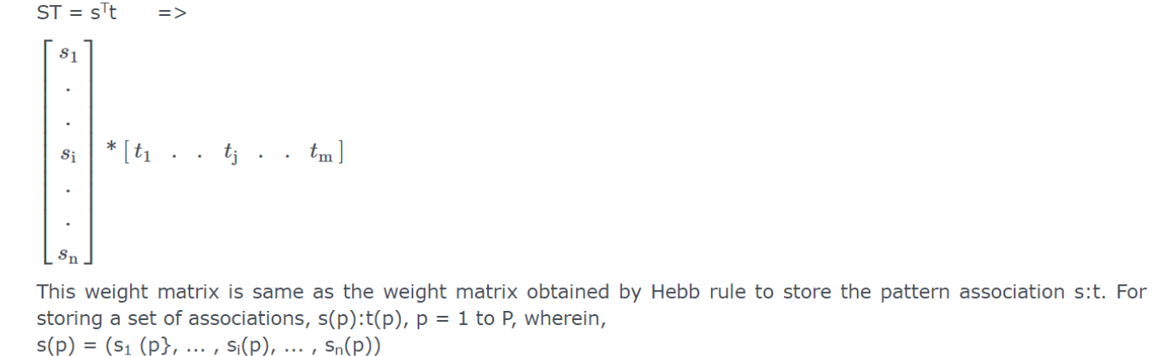
Training Algorithms for Pattern Association
The outer product of the two vectors is the product of the matrices
S = s^{T} and T = t, i.e., between [n X 1] matrix and [1 x m] matrix.
The transpose is to be taken for the input matrix given.

Slide 20

Training Algorithms for Pattern Association
This weight matrix is same as the weight matrix obtained by Hebb rule to store the pattern association s:t.
For storing a set of associations, s(p):t(p), p = 1 to P, wherein,
s(p) = (s1 (p}, ... , si(p), ... , sn(p))
t(p) = (t1 (p), · · ·,tj(p), ··· ,tm(p))
The weight matrix W = {wij} can be given as

Slide 21
Auto Associative Memory
An auto-associative memory recovers a previously stored pattern that most closely relates to the current pattern.
It is also known as an auto-associative correlator.
In the auto associative memory network, the training input vector and training output vector are the same.

Slide 22
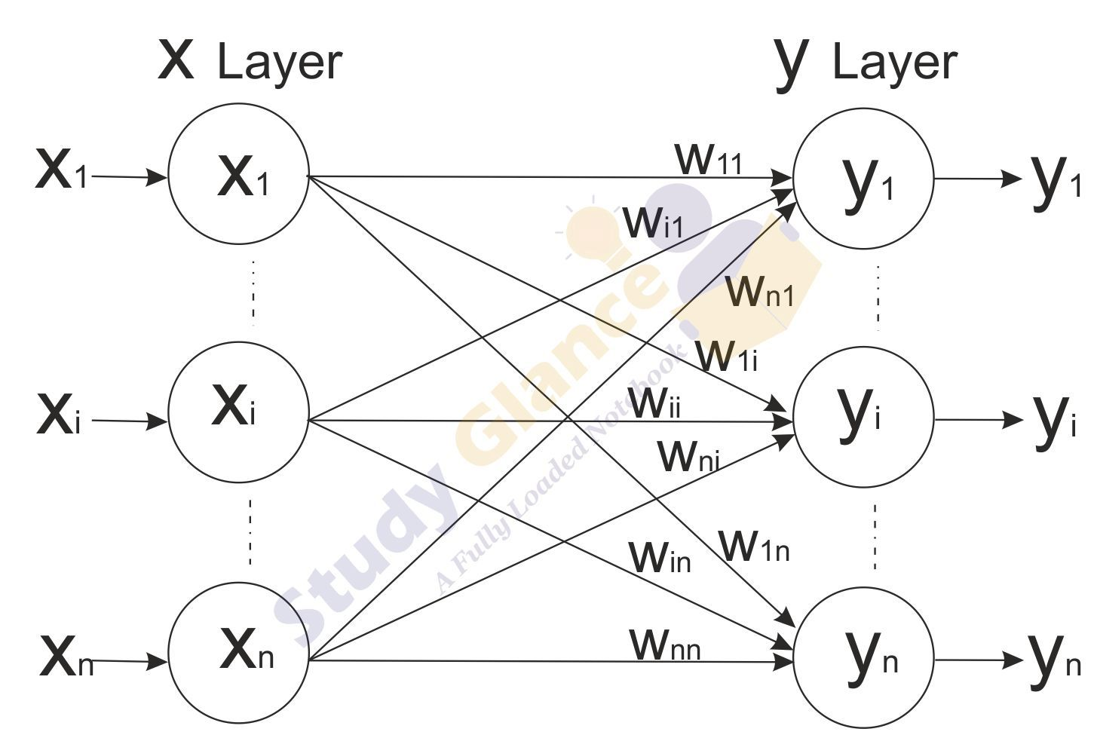
Auto Associative Memory Architecture

Slide 23
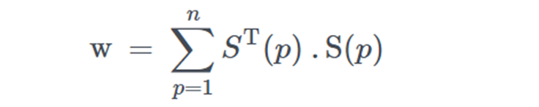
Auto Associative Memory Algorithm
Training Algorithm
For training, this network is using the Hebb or Delta learning rule.
Step 1 − Initialize all the weights to zero as wij = 0 i=1 to n, j=1 to n
Step 2 − Perform steps 3-4 for each input vector.
Step 3 − Activate each input unit as follows −
xi=si (i=1 to n)
Step 4 − Activate each output unit as follows −
yj=sj (j=1 to n)
Step 5 − Adjust the weights as follows −
wij(new)=wij(old)+xi yj
The weight can also be determine form the Hebb Rule or Outer Products Rule learning

Slide 24
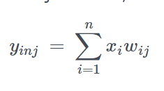
Auto Associative Memory Algorithm
Testing Algorithm
Step 1 − Set the weights obtained during training for Hebb’s rule.
Step 2 − Perform steps 3-5 for each input vector.
Step 3 − Set the activation of the input units equal to that of the input vector.
Step 4 − Calculate the net input to each output unit j = 1 to n;
Step 5 − Apply the following activation function to calculate the output

Slide 25
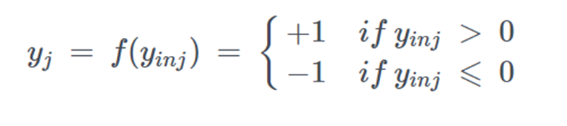
Auto Associative Memory Algorithm
Step 5 − Apply the following activation function to calculate the output.

Slide 26
Hetero Associative Memory
In a hetero-associate memory, the training input and the target output vectors are different.
The weights are determined in a way that the network can store a set of pattern associations. The association here is a pair of training input target output vector pairs (s(p), t(p)), with p = 1,2,…P.
Each vector s(p) has n components and each vector t(p) has m components.
The determination of weights is done either by using Hebb rule or delta rule.
The net finds an appropriate output vector, which corresponds to an input vector x, that may be either one of the stored patterns or a new pattern.

Slide 27
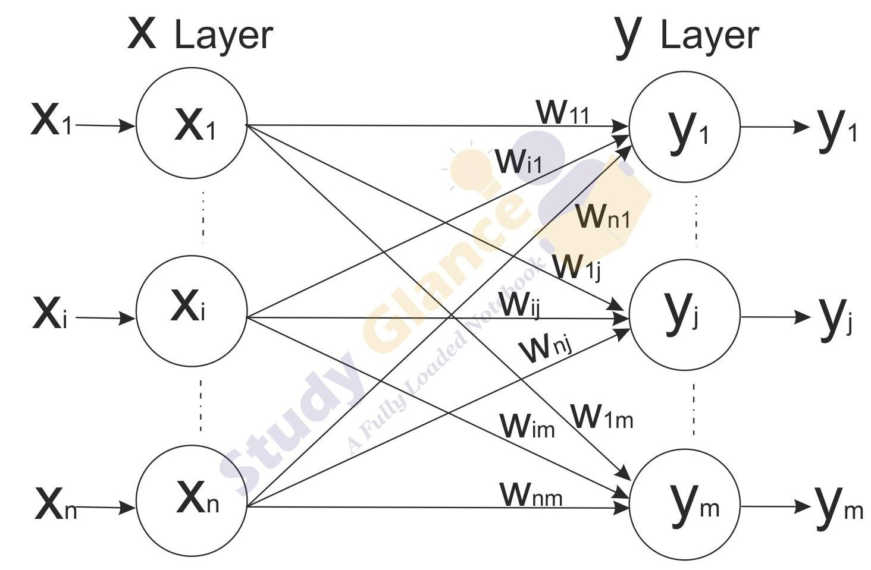
Hetero Associative Memory Architecture

Slide 28
Hetero Associative Memory Algorithm
Training Algorithm
Step 1 − Initialize all the weights to zero as wij = 0, i= 1 to n, j= 1 to m
Step 2 − Perform steps 3-4 for each input vector.
Step 3 − Activate each input unit as follows −
xi=si (i=1 to n)
Step 4 − Activate each output unit as follows −
yj=sj (j=1 to m)
Step 5 − Adjust the weights as follows −
wij(new)=wij(old)+xi yj

Slide 29
Hetero Associative memory
The weight can also be determine form the Hebb Rule or Outer Products Rule learning.

Slide 30
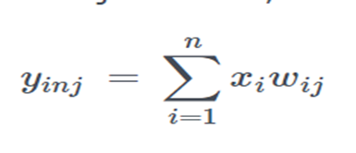
Hetero Associative memory
Testing Algorithm
Step 1 − Set the weights obtained during training for Hebb’s rule.
Step 2 − Perform steps 3-5 for each input vector.
Step 3 − Set the activation of the input units equal to that of the input vector.
Step 4 − Calculate the net input to each output unit j = 1 to m;

Slide 31
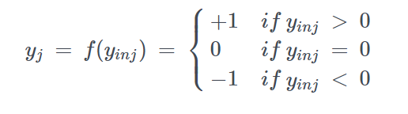
Hetero Associative Memory
Step 5 − Apply the following activation function to calculate the output.

